Slide 1
Operational Reviews
Presented by
Corey A. Pfaffe, CPA, PhD
February 2022
Notes:
At the February 2021 Tweakage, we led two discussions:
A review of 2020 and peak into 2021 with an eye on improvements in budgeting systems and vision casting
A review of camp staff compensation strategies
This week, we will discuss two new topics:
Financial mistakes of camp ministries
Operational reviews
Workshop #2, Operational Reviews – Improving Your Camp’s Financial Stewardship
There is great power in asking the right questions, especially as Christian camp leaders seek to improve their financial stewardship. An operational review of a camp’s revenue and expenditure cycles, compensation practices, financial reporting, and other financial matters is designed to unearth untapped strengths and overlooked opportunities. However, the right questions must be asked. This workshop equips camp leaders to take the lead in enhancing financial stewardship by gaining on-target answers.
MinistryCPA is engaged by ministries to perform Operational Reviews. To date, our availability has been limited to 12-13 per year. But your camp may have an outside accounting firm or knowledgeable and experienced Board member who could serve this role and use our templates which we would be glad to share.

Slide 2
REACHING GLOBALLY,
SERVING PERSONALLY
Accounting professionals and administrative staff located at offices in Watertown, Wisconsin and remotely
Church and Christian ministry clients in 39 U.S. States and six Continents
Our Mission: To help others improve their financial stewardship
Notes:
This PowerPoint presentation and extensive material in the Notes Page View is available on our website under “Resources & Tools.”

Slide 3
6 Common Financial Mistakes
We’ve Seen Camps Make
Topics covered Workshop #1
Walking blind
Using a Garmin
A bag with holes
Poking a stick in a hornet’s nest
Paying weakly
No “buddy system”
Operational Reviews
Notes:
DISCUSSION from Workshop #1: ANY ADDITIONS??????????????????????????
What financial matters have threatened to keep you awake at night?
An uninsured loss?
Camper / staff injuries?
Delayed repairs that turn from preventative to break down?
Key donors who stop supporting the camp?
Inflation?
Government fines or regulations?
Misleading financial reports?
Staff financial troubles?
Staff mistakes or carelessness?

Slide 4
What is an Operational Review?
An exploration of a camp’s financial management functions…
By knowledgeable “outsiders”…
Who document and evaluate the camp’s financial stewardship…
Reporting their findings and offering recommendations.
What it is NOT! – an Independent CPA audit
…but can help a camp to get ready for one, if needed
Operational Reviews
Notes:
DISCUSSION:
Has your camp recently had “outsiders” explore your camp facilities, programs or practices and offer recommendations?
Please tell us about it. What did they do? Was it worthwhile? What might you do differently if there is a “next time”?

Slide 5
Why Engage an Operational Review?
To improve the camp’s financial stewardship over its assets—tangible and intangible, liquid and illiquid
To protect the camp and those who serve its financial functions
To enhance the credibility of the camp’s financial stewardship with its Board, its supporters, and others
To assess the camp’s financial support of its resident and summer staff
To gain efficiencies and quality in its routine processes and its tools for financial decision-makers
Operational Reviews
Notes:
Purpose of Operational Reviews (Source: MinistryCPA communique)
Organizations that seek to improve their financial stewardship engage us for a variety of purposes. Every operational review leads to the delivery of a report of our findings, commendations and recommendations after appropriate discovery using documents received from our clients and following up with necessary inquiries. We often also communicate what we believe to be unique opportunities or, perhaps, threats to the organization given our understanding of the broader field in which it serves. For example, a Christian camp may experience financial conditions that we have observed in other client ministries that can be valuable to convey within our report.
A church or Christian ministry may also request an operational review by MinistryCPA accountants as it prepares for an audit by a local independent CPA firm. The advance preparation can facilitate what can be referred to as a “tic and tie” audit in which the independent CPA finds the organization’s processes and records in excellent condition and ready for the most efficient and cost-effective audit process. While MinistryCPA does not perform independent audits, we have training and experience in their conduct.

Slide 6
What are the Processes and Results of an Operational Review?
Data collection
Financial reports and databases
Camp manuals
Inquiries related to the revenue and expenditure cycles, financial and management reporting systems, compensation practices, and other financial matters
Report and Discussion of Operational Review
Findings
Recommendations
Operational Reviews
Notes:
Process of Operational Reviews (Source: MinistryCPA communique)
Once we gain an initial understanding of the scope of a church’s or Christian organization’s ministry, we typically request that a list of files and documents be uploaded to our secure client portal. The list might look something like the following and is intended to touch on the ministry’s revenue and expenditure cycles, financial and management reporting systems, compensation practices and other matters.
up-to-date backup copy of QuickBooks data file or access to exported financial reports
copy of approved current year budget
summaries of each employee’s approved compensation and benefits arrangements
copies of year-end bank and investment statements
copies of insurance policy declaration pages
copy of church or ministry constitution or bylaws
copies of prior and current year minutes of organization-level meetings
description of each designated funds solicited and managed by the organization, and
descriptions of the following current procedures or processes regarding
receipt and deposit of contributions and other cash receipts,
approval and payment of disbursements,
adoption of annual budget,
evaluation of compensation arrangements,
maintenance of donor management records,
issuance of interim financial reports,
issuance and use of credit cards, and
reimbursement of employee ministry expenses.
Some ministries also request our operational review of accounts receivable invoicing, credit, and collections procedures; revenue recognition and forecasting; budget systems and practices; capital expenditures and depreciation policies; accounting methods; cash flow management; designated fund reporting and management; compliance with government payroll and other regulatory requirements; and internal “audit” functions.
Depending on the wishes of the ministry, our work can be conducted partially or entirely on a remote basis. Typically, our final report is presented and discussed either in person or via videoconferencing. Frequently, clients request our assistance in the implementation of our recommendations.

Slide 7
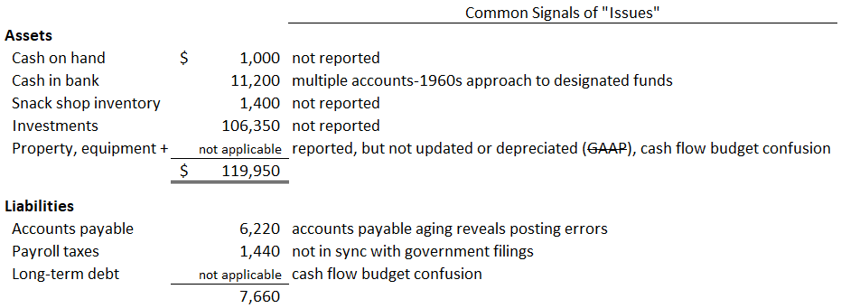
Common Findings and Recommendations
Based on Financial Reports—the Balance Sheet
Operational Reviews
Notes:
We’ve seen these hypothetical camp financial reports before – in workshop #1
Assets –
all camp assets should be listed on the balance sheet and fall under the oversight of the ministry, its processes and its protections.
Some camps attempt to have multiple bank accounts, even in some cases with multiple banks in order to keep funds in separate “buckets” – this is unnecessary, inefficient and open to errors when a properly structured chart of accounts in modern accounting software can be easily designed to track these “buckets”.
Unless an audit report by an Independent certified public accountant firm is required (and it rarely is), we recommend using a Modified Cash Basis of accounting that excludes long-term assets and long-term liabilities from the balance sheet. Separate reporting, especially, if long-term debt is present may be required, but it relatively simple compared to implement full GAAP/accrual accounting.
Most camp budgets, we believe, are primarily concerned about managing cash flows. A, for example, $10,000 used vehicle purchase must either be funded as an expense of current operations right along with other current demands or be paid for by solicitations of designated giving. GAAP/accrual accounting would report the transaction on the balance sheet, having no impact on the operating budget, except for subsequent years’ “paper” depreciation general journal entries.
Liabilities –
Accounts payable on the balance sheet represents the total of all operating invoices not yet paid by the date of the balance sheet. A listing/aging of unpaid invoices often reveals posting errors related to invoices and payments related to vendors.
Payroll tax liabilities, if correctly reported on the balance sheet, will be reduced to zero as government forms are filed and payments made shortly after the balance sheet date.
Similar to fixed assets, discussed above, interest AND principal payments must come from operating cash. Using the Modified Cash Basis of accounting requires a P&L account often labeled “P&I payments on LT debt” where both the principal and the interest components of monthly payments are recorded. Then, a supplementary schedule is prepared and reported to financial leaders so they can observe debt reduction not reported on the balance sheet.

Slide 8
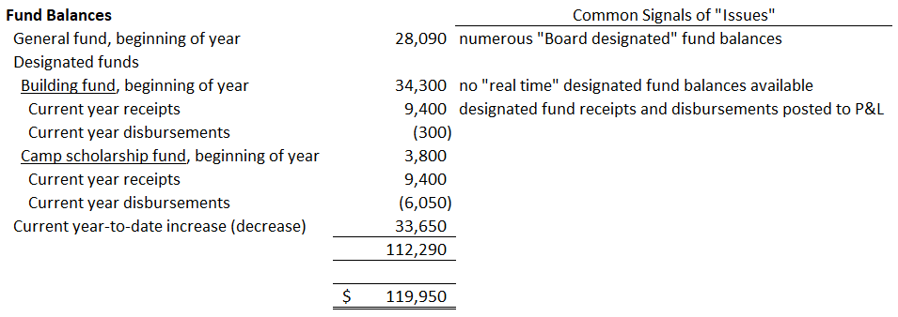
Common Findings and Recommendations
Based on Financial Reports—the Balance Sheet
Operational Reviews
Notes:
General fund balances
We recommend restraint in creation of multiple “board restricted” funds (the GAAP name for set asides of general funds not restricted by donors). They are not true designated funds for which the camp has a fiduciary and legal duty to honor donors’ designations. So they can be reversed. But it can be an unnecessarily unpopular decision once some board or staff members “have their heart set on it.”
“Real time” designated fund accounting - Combination of the beginning of year balance (this “Title” account is only adjusted on the first date of the next fiscal year, otherwise transactions are never posted to it), plus current year receipts (a “Sub” account), minus current year disbursements (a “Sub” account), equals the current unexpended balance. In some softwares (e.g., QuickBooks) the three accounts are easily collapsed into a single account for interim and year-end report presentation purposes.

Slide 9
Common Findings and Recommendations
Based on Financial Reports—the Income Statement
Operational Reviews
Notes:
Income
Contributions should be forecasted so a true $0 balance budget can be presented
After reviewing interim reports it is often apparent that initial income forecasts are inaccurate. Mid-course corrections can be considered if the ministry adopts a “dynamic budgeting” philosophy.
Some ministries are not in compliance with sales tax rules
Other – designated gifts should not be posted to the Income Statement which should be used only for the “unrestricted” general fund and its budget.

Slide 10
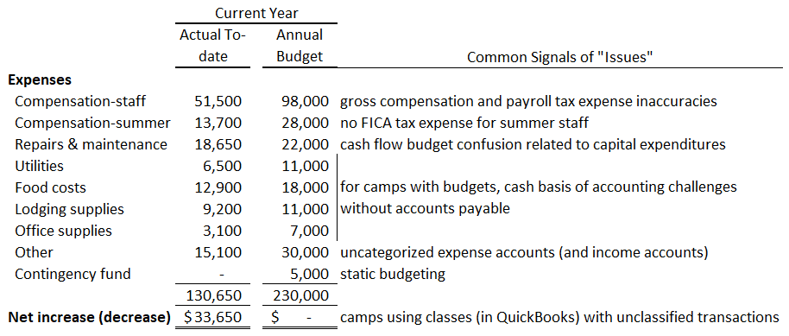
Common Findings and Recommendations
Based on Financial Reports—the Income Statement
Operational Reviews
Notes:
Expenses
Salaries and wages should be posted as gross amounts, not net check amounts, so that budget comparisons can be made. An inordinately high payroll tax balance compared to the inordinately low salary and wage expense balance will likely expose this error.
Summer staff compensation is almost always subject to FICA tax. Exceptions – ministers and church camps with Form 8274 elections.
Repairs & maintenance – consider budgeting and posting to an account “Capital Expenditures” for large, one-time planned improvements that are funded by the General Fund
By using the accounts payable functions of your accounting software late fiscal year expenditures not paid until the next fiscal year still hit the right budget.
We see evidence of static budgeting where overspending the budget and significant underspending of expenditure budgets seems to go unnoticed or unaddressed
Camps that use classes (at least in QuickBooks) should run periodic P&L by class to determine whether any unclassified transactions need to be edited and assigned to a class

Slide 11
Common Findings and Recommendations
Based on Inquiries
Reasonable processes to protect the camp and those who serve its financial functions
Improvements to donor, Board and staff relations
Opportunities for “smart” compensation
Systems for annual and long-term financial planning
Threats to tax-exempt status
Operational Reviews
Notes:
Accountants can recommend internal controls that are considerate of the generally small number of financial staff typical in camps
Accountants are businesspeople themselves. Their experience in client, management and human resource relations can be applied to many camp relationships (e.g., helping tax savvy donors; communicating concisely and timely with Board members; another set of eyes on team culture).
Accountants can suggest cost conscious options camps can add to employee benefits.
Accountants can recommend and help implement budgeting tools and perspectives-both annual and multi-year
Accountants can spot risky behaviors that can jeopardize tax deductibility of donations, real estate tax exclusions and taxable vs. tax-exempt revenue sources

Slide 12
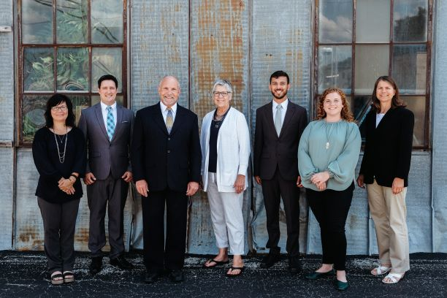
REACHING GLOBALLY,
SERVING PERSONALLY
Our Mission: To help others improve their financial stewardship
Notes:
Please contact MinistryCPA to discuss how we may serve your ministry.
This PowerPoint presentation is available on our website under “Resources & Tools.”

